Slide 1
Module V
Leadership and Organizational Culture

Slide 2
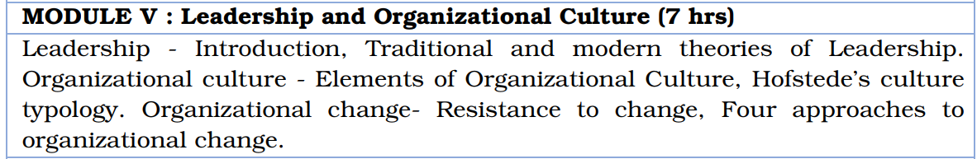
Syllabus

Slide 3
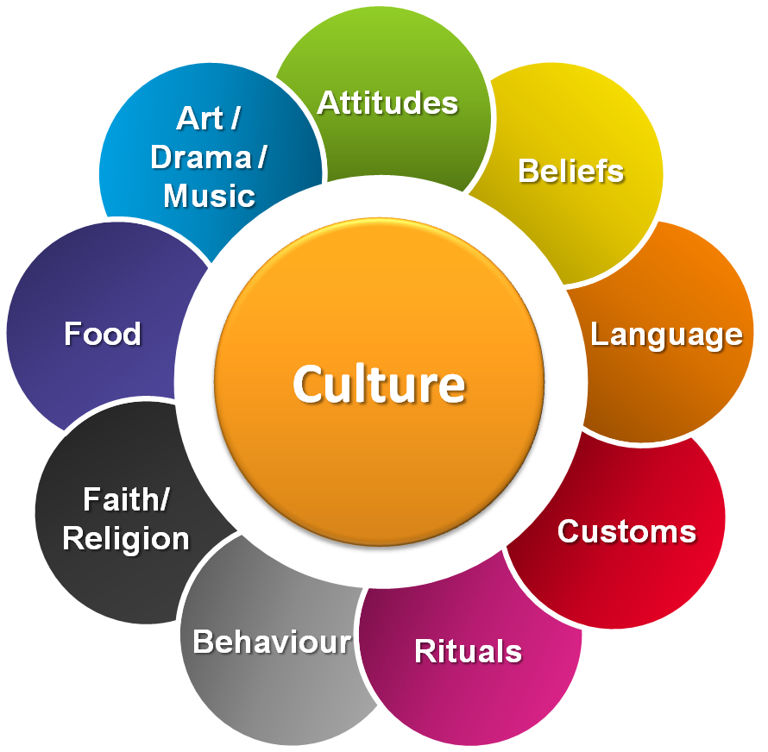
Organizational culture
Values and assumptions shared within an organization
What is important and what is unimportant in an organization
Directs everyone in the organization toward the right way of doing things
Elements of Org. Culture:
Assumptions, Values and beliefs
Artifacts
Org Language
Org structures and symbols

Slide 4
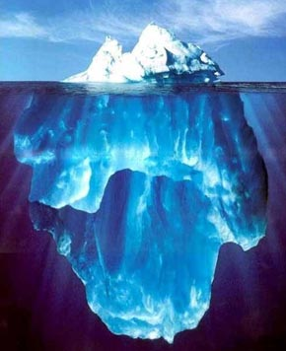

“Culture is like an iceberg…” (E. Hall 1976)
…Where some parts are visible while others are not. Still, not visible elements are the basis of the whole iceberg/culture…

Slide 5
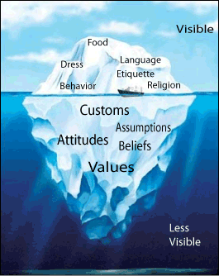
“Culture is like an iceberg…” (E. Hall 1976)

Slide 6
Elements of Organizational Culture:
Shared Values: Stable, evaluative beliefs that guide our preferences for outcomes or courses of action in a variety of situations.
Shared assumptions: Nonconscious, taken for granted perceptions or ideal prototypes of behavior that help to think and act towads problems.
Yahoo : Excellence, Innovation, Customer fixation, Teamwork, Community and Fun

Slide 7
Elements of Organizational Culture:
Espoused values: Publicly stated ideals that an organization promotes.
Enacted values: Actual behaviors and actions that demonstrates an organizations or individuals values in practice.

Slide 8
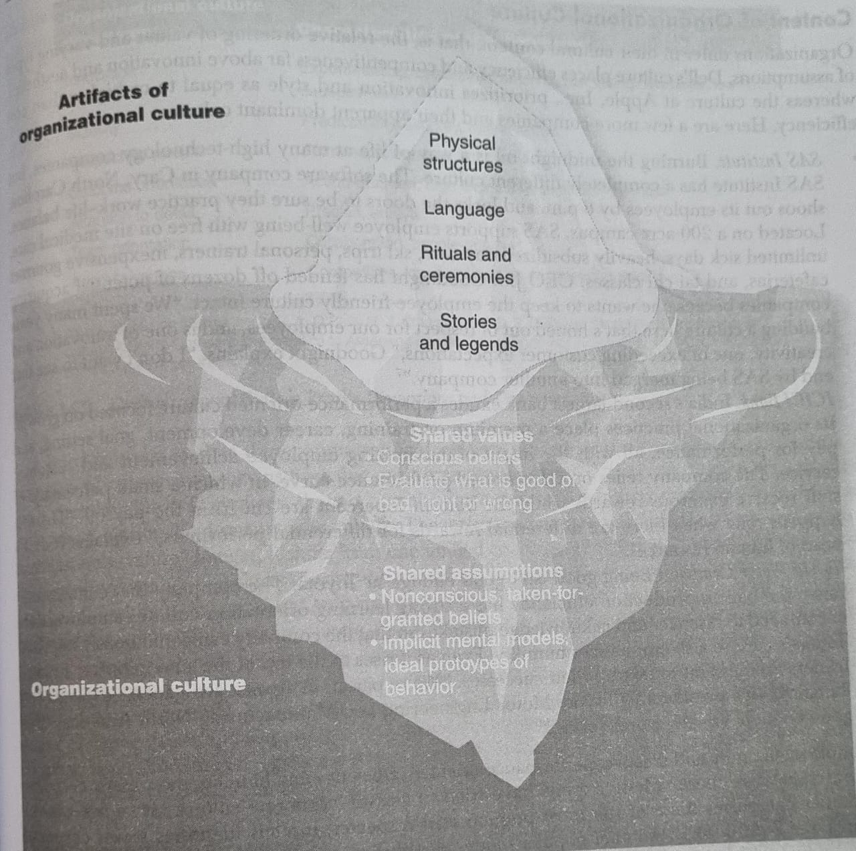
Fig: Organizational Culture assumptions, Values and artifacts

Slide 9
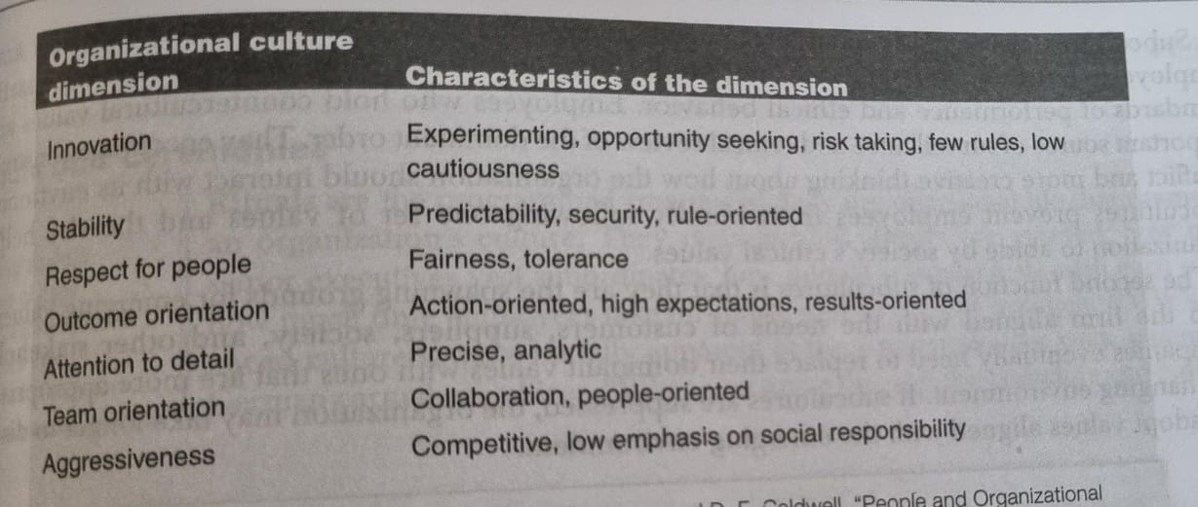
Fig: Organizational Culture Profile dimensions and characteristics

Slide 10
Organizational subcultures:
Dominant culture and sub culture??
Artifacts: Observable symbols and signs of an organization’s culture.
Eg: The way visitors are greeted, physical layout of an organization, reward to employees etc.
Support changes to an org culture.

Slide 11
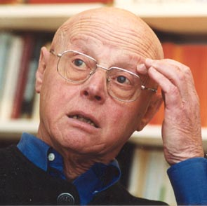
Hofstede’s Culture typology
Hofstede's cultural dimensions theory, developed by Geert Hofstede
Famework for cross-cultural communication.
Regional and national cultures do have a considerably impact on people´s behavior.
After conducting a large survey study 1967-1973, he came up with six dimensions.
Refer for Materials:
https://www.simplypsychology.org/hofstedes-cultural-dimensions-theory.html
https://corporatefinanceinstitute.com/resources/management/hofstedes-cultural-dimensions-theory/
https://newsmoor.com/cultural-dimensions-hofstedes-cultural-dimensions-theory-with-six-dimension/

Slide 12
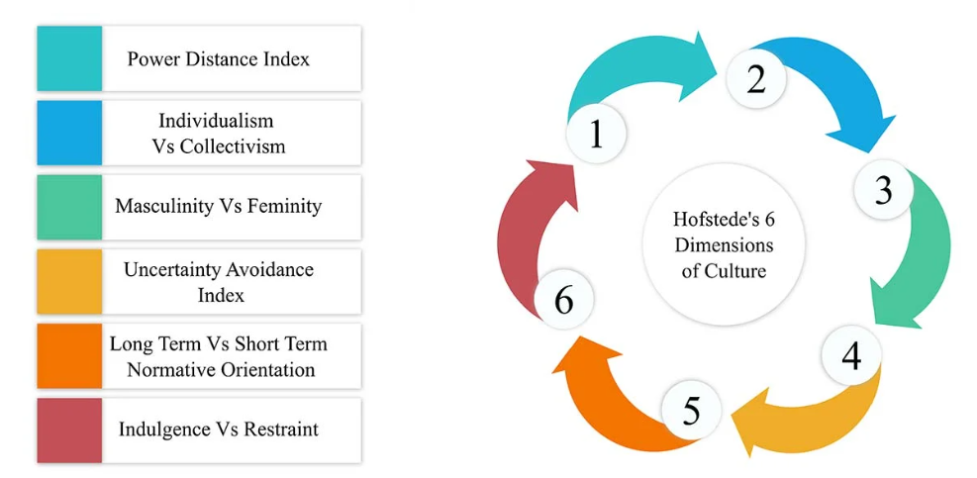
Cultural Dimensions: Hofstede

Slide 13
Hofstede’s Culture typology
Power-Distance Index : Extent to which the less powerful members of an organization or institution accept and expect that power is distributed unequally
High degree of power distance
Culture accepts inequity and power differences
Encourages bureaucracy
Shows high respect for rank and authority
Parents may expect children to obey without questioning their authority
Low power distance
Culture encourages flat organizational structures
Decentralized decision-making responsibility
Participative management style
Emphasis on power distribution
Equality between parents and children

Slide 14
Hofstede’s Culture typology
Individualism vs. Collectivism: Degree to which societies are integrated into groups and their perceived obligations and dependence on groups.
Individualistic societies
Emphasis lies on personal achievement and rights
Prioritizing the needs of oneself and one’s immediate family.
Collectivism
Greater importance placed on the goals and well-being of the group
A person’s self-image in this category is defined as “We”
Individuals from collectivist backgrounds often prioritize relationships and loyalty more prominently than those in individualistic cultures

Slide 15
Hofstede’s Culture typology
Uncertainty Avoidance Index : How unknown situations, uncertainty, and unexpected events are dealt with.
High uncertainty avoidance index
Low tolerance for uncertainty, ambiguity, and risk-taking
Unknown is minimized through strict rules, regulations, etc.
Both the institutions and the individuals in these societies strive to reduce uncertainty by employing vigorous rules, regulations, and similar measures.
Low uncertainty avoidance index
High tolerance for uncertainty and ambiguity
Unknown is more openly accepted
Embrace and feel at ease in situations lacking structure or in fluctuating environments.

Slide 16
Hofstede’s Culture typology
Masculinity vs. femininity dimension: Gender role differentiation and examines the extent to which a society values traditional masculine and feminine roles.
Masculinity includes the following characteristics: distinct gender roles, an appreciation of assertiveness, courage, strength, and competition.
Femininity includes characteristics such as fluid gender roles, modest, nurturing, and concerned with the quality of life.
High femininity score: A country with a high rating would probably offer improved maternity benefits and more accessible childcare services.
Lower femininity score: Likely to highlight increased female representation in leadership roles and a higher prevalence of female entrepreneurship.

Slide 17
Hofstede’s Culture typology
Long-Term Orientation vs. Short-Term Orientation: Considers the extent to which society views its time horizon
Societies that emphasize long-term orientation
Prioritize future outcomes
Postponing immediate success for achievements over the long term
Values like persistence, endurance, frugality, savings, sustained growth and adaptability take centre stage
Short-term orientation
Focus on the near future
Involve delivering short-term success or gratification
Place a stronger emphasis on the present than the future
Emphasizes quick results and respect for tradition

Slide 18
Hofstede’s Culture typology
Indulgence vs. Restraint dimension: Extent and tendency for a society to fulfill its desires.
Indulgence: Society allows relatively free gratification related to enjoying life and having fun.
Restraint: Society suppresses gratification of needs and regulates it through social norms.
High indulgence: Individuals allocating more funds to luxuries and relishing greater freedom in their leisure pursuits
Restrained society: Inclination leans towards thrift, savings, and practical necessities.

Slide 19
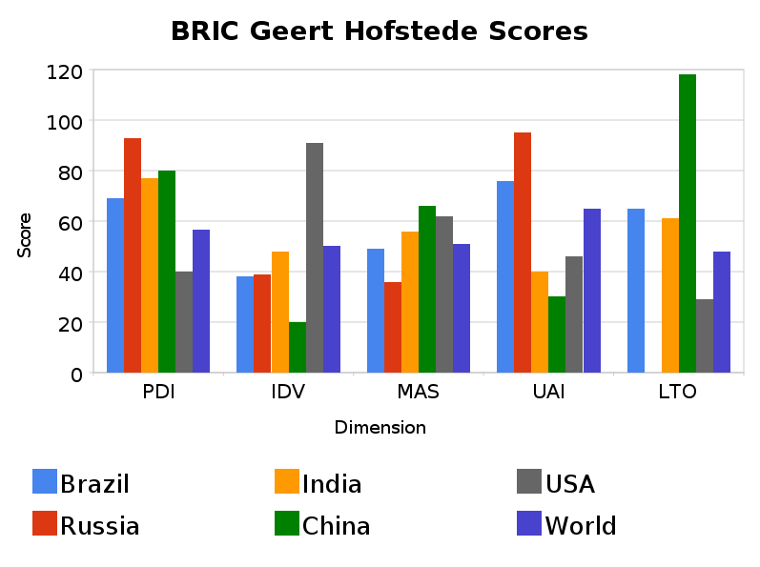
Country Examples
PDI: Power Distance Index
IDV: Individualism
MAS: Masculinity
UAI: Uncertainty Avoidance
LTO: Long Term Orientation/ Time Perspective
For other countries, you can find a lot in the internet.

Slide 20
Organizational change
Actions taken to modify a significant component of its structure, strategies, processes, culture, or technologies
Enhance performance, adapt to evolving environments, or address internal issues

Slide 21

Changing People: Some Basic Steps
Incorporating the changes,
creating and maintaining a
new organizational system
Step 3: Refreezing
Attempting to
create a new state
of affairs
Step 2: Changing
Current State New State
Recognizing the
need for change
Step 1: Unfreezing

Slide 22
When Will It Occur?
Change
is made
If benefits exceed costs
Amount of dissatisfaction
with current conditions
Compared
to
Cost of
making
change
Availability of a
desirable alternative
Benefit of
making
change
Existence of a plan for
achieving a desirable
alternative
Change is
not made
If costs exceed benefits

Slide 23
Lewin’s Force Field Analysis
Restraining
Forces
Desired
Conditions
Restraining
Forces
Driving
Forces
Restraining
Forces
Driving
Forces
Current
Conditions
Driving
Forces
Before Change
During Change
After Change

Slide 24
Resistance to Change
Direct Costs
Saving Face
Fear of the Unknown
Breaking Routines
Incongruent Systems
Incongruent Team Dynamics
Forces for
Change

Slide 25
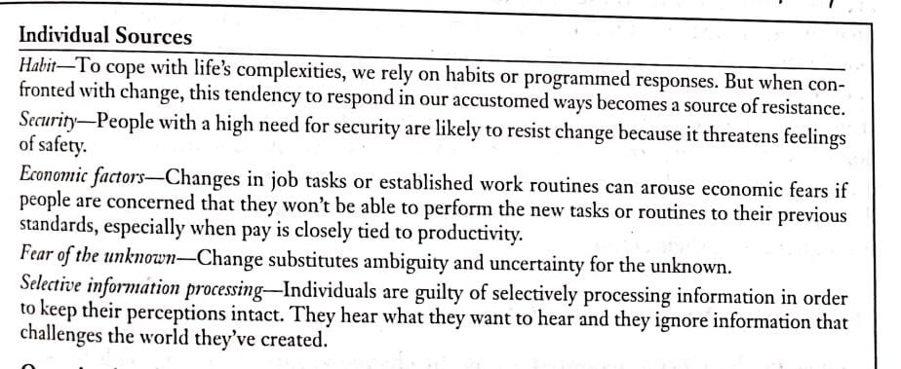
Resistance to Change. Sources:

Slide 26
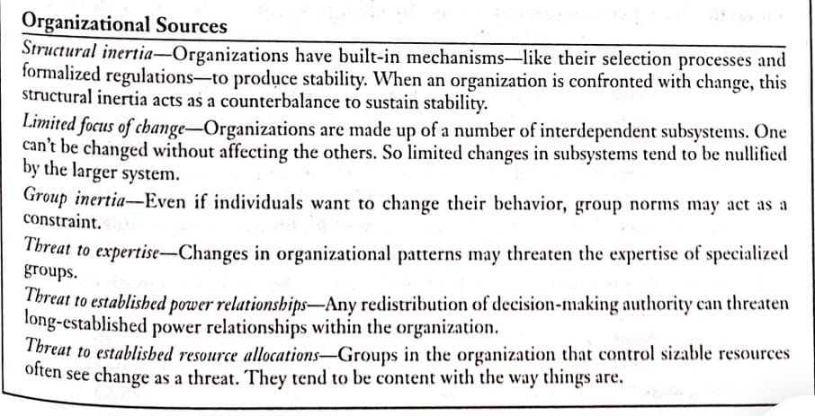
Resistance to Change. Sources:

Slide 27
Creating an Urgency for Change
Need to motivate employees to change
Most difficult when organisation is doing well
Must be real, not contrived
Customer-driven change
Adverse consequences for firm
Human element energizes employees

Slide 28
Minimizing Resistance to Change
Communication
Minimizing
Resistance
to Change
Coercion
Training
Negotiation
Employee
Involvement
Stress
Management

Slide 29
Action Research Process :
Four Approaches to Organizational Change.
A problem focused change process that combines action orientation(changing attitudes and behavior) and research orientation(testing theory through data collection and analysis).
Establish
Client-
Consultant
Relations
Diagnose
Need for
Change
Introduce
Change
Evaluate/
Stabilize
Change
Disengage
Consultant’s
Services

Slide 30
Parallel Learning Structures
A highly participative arrangement composed of people from most levels of the organization; who follow the action research model to produce meaningful organizational change.
Organization
Parallel
Structure

Slide 31
Appreciative Inquiry Process
An organizational change strategy that directs the group’s attention away from its own problems and focuses participants on the group’s potential and positive elements.
Discovery
Dreaming
Designing
Delivering
Discovering the best of “what is”
Forming ideas about “what might be”
Engaging in dialogue about “what should be”
Developing objectives about “what will be”
Fig: The Four-D Model of Appreciative Inquiry

Slide 32
Large Group Interventions
Strategy that consists of systemwide group sessions, usually lasting a few days, in which participants identify trends and establish ways to adapt to those changes.
Eg:- Future Search, “ puts the entire system in the room”, means that the process tries to involve as many employees and other stakeholders as possible associated with the system.

Slide 33
Leadership
→ability to influence and inspire others to work collaboratively towards a common goal, requiring the leader to guide, motivate, and empower individuals to achieve organizational objectives.
Can be defined in terms of group processes, personality, compliance, behaviors, power, goal achievement, interactions etc:-
Individual can be a leader without being a manager and can be a manager without being a leader.
Historical theories: Lowa leadership study, The ohio state leadership study, The Early Michigan Leadership study.

Slide 34
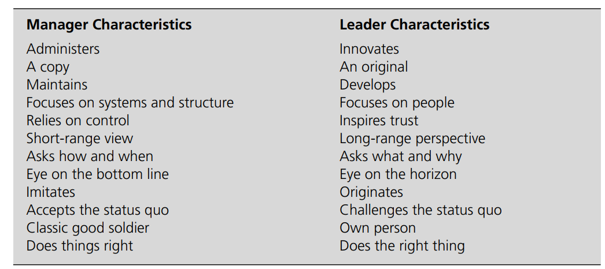
Leadership
What makes Leaders different from managers?
Organizational leader: “The heroic individual, often charismatic, whose positional power, intellectual strength, and persuasive gifts motivate followers”

Slide 35
Traditional theories of Leadership
Great person theory of leadership: Leaders were felt to be born, not made
Some individuals are born with certain traits that allow them to emerge out of any situation or period of history to become leaders
Genetics and hardwiring may play in leadership
Leadership is affected by both nature (genetics) and nurture (development)
Trait theory of leadership : Identifying the personality traits of the leader
Attention was given to the search for universal traits possessed by leaders
Leaders were bigger and brighter than those being led, but not too much so
Leader was more intelligent than the average of the group being led, but, interestingly, was not the most intelligent of the group

Slide 36
Traditional theories of Leadership
Trait theory of leadership :
“Big Five” personality traits
Moving away from a strict traits approach
Optimism, hope, resiliency, emotional intelligence, and especially self-efficacy
Skill development
Creativity, organization, persuasiveness, diplomacy and tactfulness, knowledge of the task, and the ability to speak well

Slide 37
Traditional theories of Leadership : Leader Competencies
Drive, or the inner motivation to pursue goals
Leadership motivation
Integrity, which includes truthfulness and the will to translate words into deeds
Self-confidence that leads others to feel confidence,
Intelligence, which is usually focused in the ability to process information, analyze alternatives, and discover opportunities
Knowledge of the business, so that ideas that are generated help the company to survive and thrive
Emotional intelligence, based on a self-monitoring personality

Slide 38
Group and Exchange Theories of Leadership
Leader provides more benefits/rewards than burdens/costs for followers
Positive exchange between the leaders and followers in order for group goals to be accomplished
Superiors make investments (e.g., salary, office space) in and receive returns (e.g., performance) from subordinates
Subordinates make investments in and receive returns from superiors
Three domains of Leadership – Leader Based, Follower Based and Relationship based

Slide 39
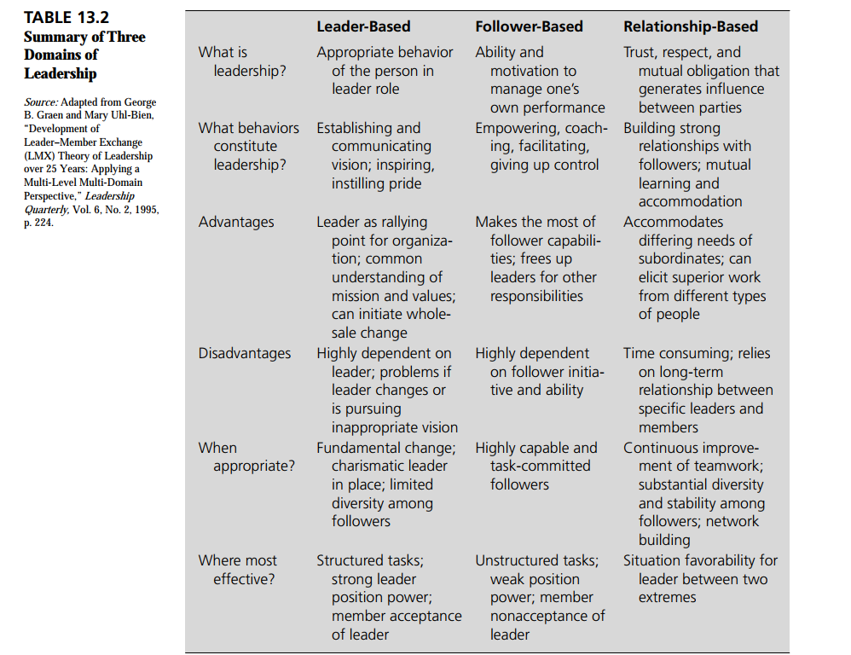
Group and Exchange Theories of Leadership

Slide 40
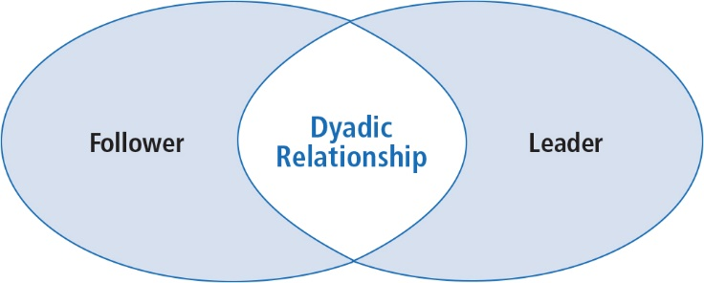
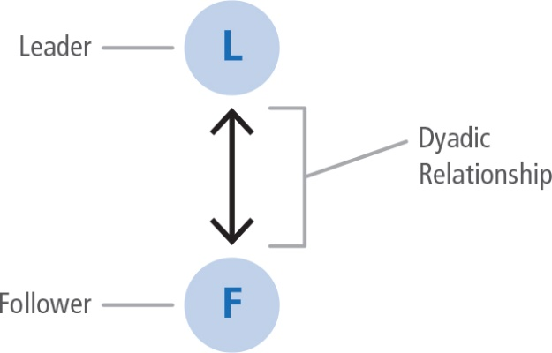
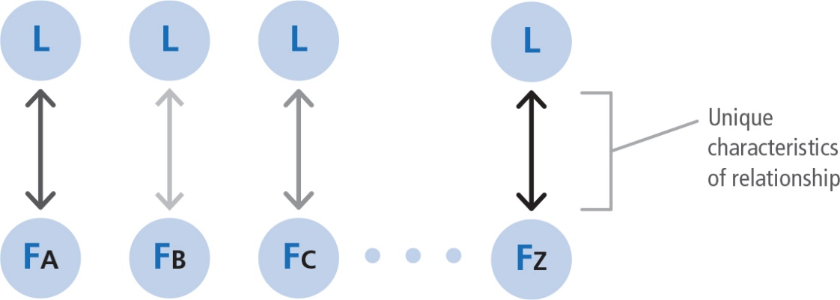
Leader-Member Exchange (LMX) Model
Conceptualizes leadership as a process
Centered on the interactions between a leader and followers
Dyadic relationship between leaders and followers
Vertical Dyadic Relationship

Slide 41
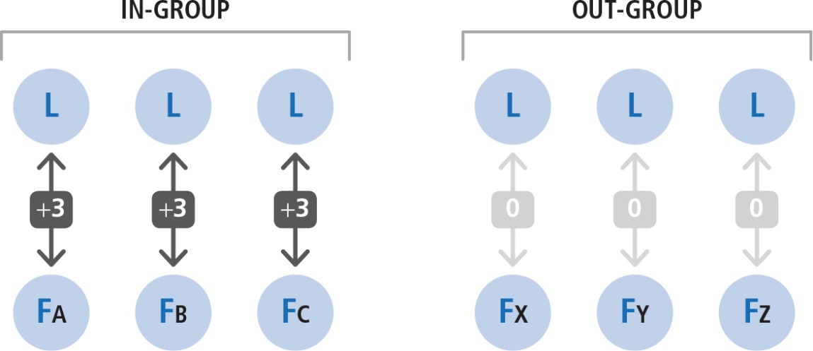
Leader-Member Exchange (LMX) Model
Researchers found two general types of linkages (or relationships)
In-group : Relationships marked by mutual trust, respect, liking, and reciprocal influence
Receive more information, influence, confidence, and concern than out-group members
Out-group :Relationships marked by formal communication based on job descriptions

Slide 42
In-Group and Out-Group Followers
In-Group
More information, influence, confidence, and concern from leader
More dependable, highly involved, and communicative than out-group
F
F
F
In-Group
Out-Group
Leader
F
F
F
F
F
F
Out-Group
Less compatible with leader
Usually just come to work, do the job, and go home
F
F
F
F
F
F
Follower

Slide 43
Leader-Member Exchange (LMX) Model
LMX has evolved through various stages:
Discovery of differentiated dyads
Investigation of characteristics of LMX relationships and their organizational implications/outcomes
Description of dyadic partnership building
Aggregation of differentiated dyadic relations to group and network levels

Slide 44
Contingency Theory of Leadership
Attention turned not only to the group being led and the exchange relationship
Situational or contextual aspects of leadership

Slide 45
Fiedler’s Contingency Model of Leadership Effectiveness
Relationship between leadership style and the favorableness of the situation
Three empirically derived dimensions:
1. The leader-member relationship, which is the most critical variable in determining the situation’s favorableness
2. The degree of task structure, which is the second most important input into the favorableness of the situation
3. The leader’s position power obtained through formal authority, which is the third most critical dimension of the situation

Slide 46
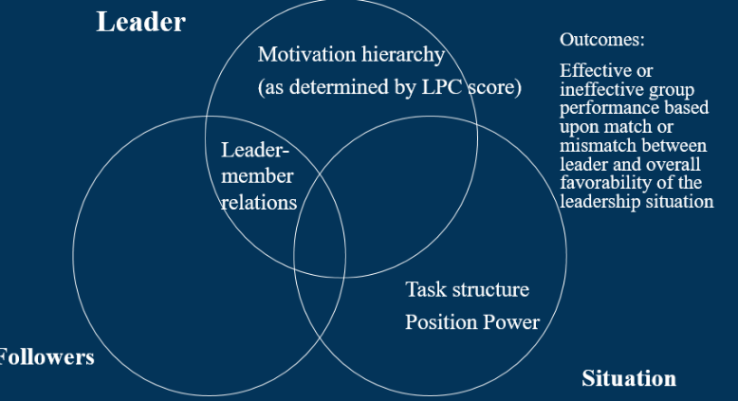
Fiedler’s Contingency Model of Leadership Effectiveness
Situations are favorable to the leader if all three of these dimensions are high.
When the situation was only moderately favorable or unfavorable (the intermediate range of favorableness), the human-oriented or democratic type of leader was most effective

Slide 47
Path Goal Leadership theory
Explains the impact that leader behavior has on associate motivation, satisfaction, and performance
Directive leadership: Associates know exactly what is expected of them, and the leader gives specific directions. There is no participation by subordinates.
Supportive leadership: The leader is friendly and approachable and shows a genuine concern for associates.
Participative leadership: The leader asks for and uses suggestions from associates but still makes the decisions.
Achievement-oriented leadership: Leader sets challenging goals for associates and shows confidence that they will attain these goals and perform well.

Slide 48
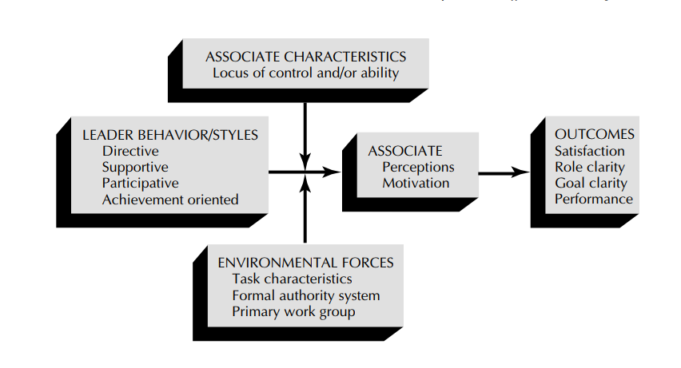
Path Goal Leadership theory
Path-goal theory — Suggests that these various styles can be and actually are used by the same leader in different situations

Slide 49
Modern Theories of leadership
Besides the established trait, group and exchange, contingency, and path-goal theories of leadership
Modern theories of leadership
Charismatic theory
Transformational theory
Substitutes theory
Authentic theories

Slide 50
Charismatic Leadership theory
Charismatic leaders are characterized by
Self-confidence
Confidence in their associates
High expectations for associates
Ideological vision
Use of personal example
Superior debating
Persuasive skills
Technical expertise
Fostering of attitudinal, behavioral & emotional changes in their followers

Slide 51
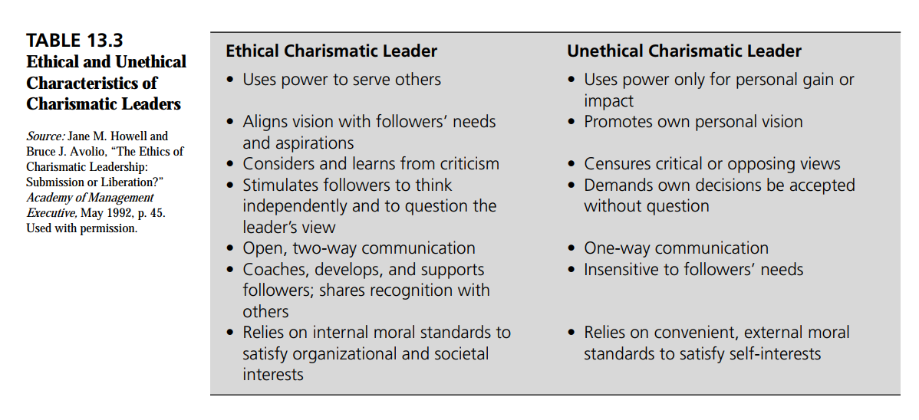
Charismatic Leadership theory
Charismatic leaders will produce in followers
Performance beyond expectations
Strong commitment to the leader and his or her mission
Situations that promote charismatic leadership include a
Crisis requiring dramatic change
Followers who are very dissatisfied with the status quo
Charismatic leadership is really just a component of the broader-based transformational leadership

Slide 52
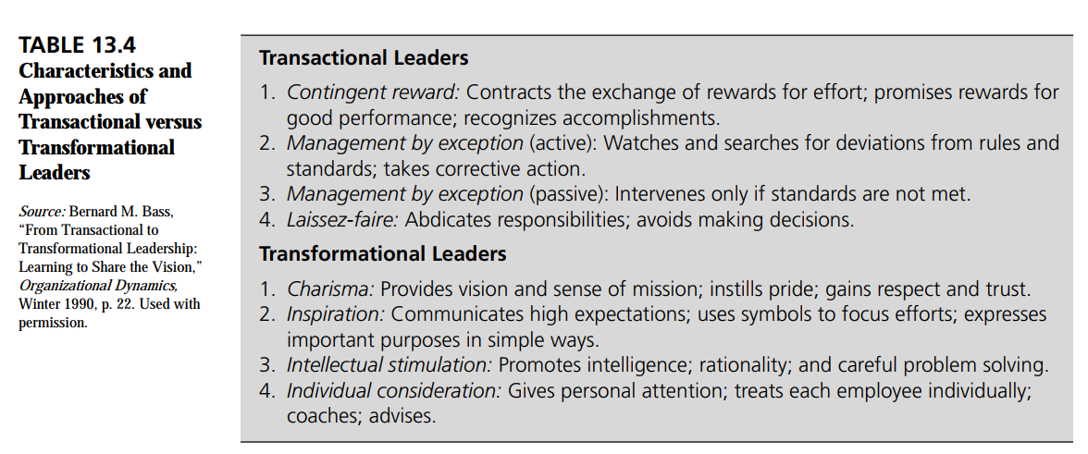
Transformational Leadership theory
James MacGregor Burns: Two types of political leadership: transactional and transformational

Slide 53
Transformational Leadership theory
Avolio: Transformational leaders are characterized by
Idealized leadership
Inspiring leadership
Intellectual stimulation
Individualized consideration represent a cluster of interrelated styles aimed at the following:
1. Changing situations for the better
2. Developing followers into leaders
3. Overhauling organizations to provide with new strategic directions
4. Inspiring people by providing an energizing vision and high ideal for moral and ethical conduct

Slide 54
Transformational Leadership theory
Tichy and Devanna: Found that effective transformational leaders share the following characteristics:
1. They identify themselves as change agents.
2. They are courageous.
3. They believe in people.
4. They are value driven.
5. They are lifelong learners.
6. They have the ability to deal with complexity, ambiguity, and uncertainty.
7. They are visionaries.

Slide 55
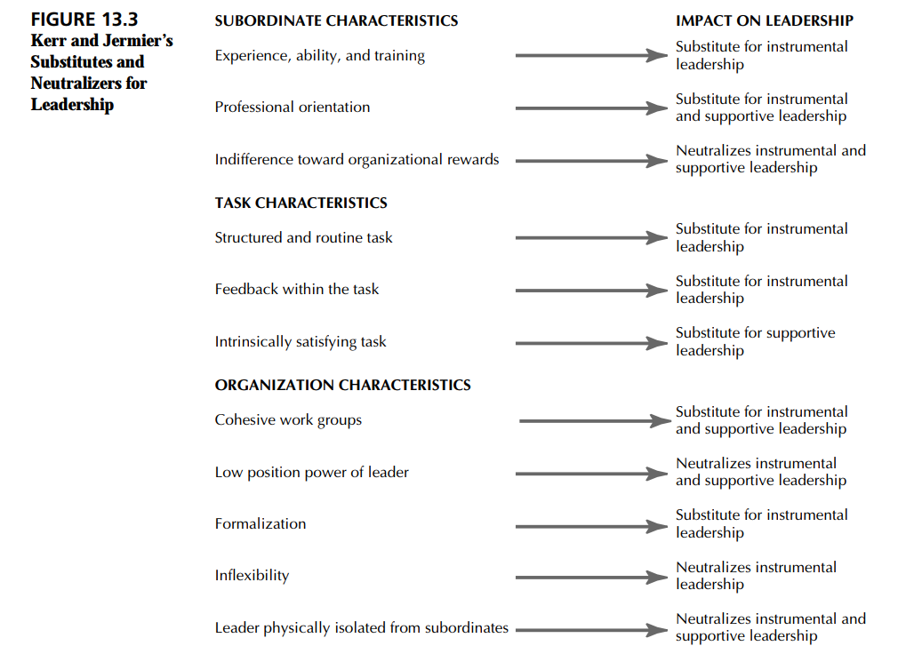
Substitutes for Leadership Theory
“Substitutes”: Make leader behavior unnecessary and redundant
Neutralizers: Prevent the leader from behaving in a certain way or that counteract the behavior
Tries to point out that some things are beyond leaders’ control
Leaders do not have mystical powers over people.
The situation or context plays a role

Slide 56
Authentic Theory of Leadership
Authentic leadership in organizations can be defined as:
A process that draws from both positive psychological capacities and a highly developed organizational context, which results in both greater self-awareness and self-regulated positive behaviors on the part of leaders and associates, fostering positive self-development.
The authentic leader is confident, hopeful, optimistic, resilient, transparent, moral/ethical, future oriented, and gives priority to developing associates to be leaders.

Slide 57
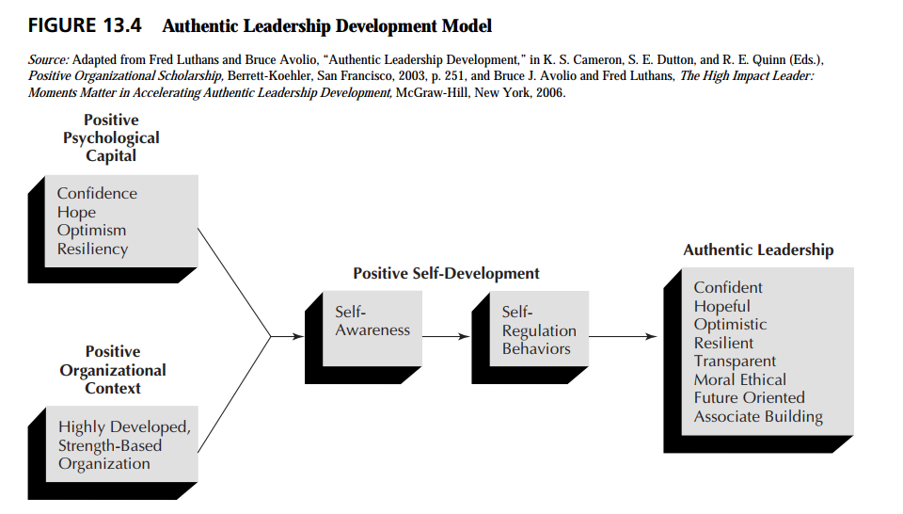
Figure depicts authentic leadership development process and product. Authentic leadership theory treat leadership as both a developmental process and product centered on authenticity.

Slide 58
Leadership across Cultures
Factors that potentially contribute to differences in effective leader processes across cultures such as :
Personal Values: The personal values held by a manager shape his or her perception of a situation, influence the analysis of alternative solutions to a problem, and affect the ultimate decision made by the leader.
Backgrounds of the Managers : Educational background, class and family status also can have an influence.
Interpersonal Skills : Leaders vary in their views of rules and procedures, deference to authority,
levels of dependence and independence, willingness to compromise, and other interpersonal tactics.

Slide 59
Project GLOBE
A major international research project by Robert House, called Global Leadership and Organizational Behavior Effectiveness(GLOBE).
Studies by 170 country-based coinvestigators (CCIs) gathered data from 18,000 managers from 62 countries.
Goal of the GLOBE project was to develop societal and organizational measures of culture and leader attributes that were appropriate to use across all cultures.
The GLOBE research indicated nine dimensions of cultures that differentiate societies and organizations as given below:
1. Power distance, or the degree to which members of a collective expect power to be distributed equally
2. Uncertainty avoidance, which is the extent a society, organization, or groups rely on norms, rules, and
procedures to alleviate the unpredictability of future events
3. Humane orientation, reflected in the degree to which a collective encourages and rewards individuals for
being fair, altruistic, generous, caring, and kind to others

Slide 60
Project GLOBE
4. Institutional Collectivism, described as the degree to which organizational and societal institutional practices
encourage and reward the collective distribution of resources and collective actions
5. In-Group Collectivism, which is the degree to which individuals express pride, loyalty, and cohesiveness in their
organizations or families
6. Assertiveness, defined as the degree to which individuals are assertive, confrontational, and aggressive in their
relationships with others
7. Gender egalitarianism, expressed as the degree a collective minimizes gender inequality
8. Future orientation, or the extent to which individuals engage in future-oriented behaviors such as delaying
gratification,planning, and investing in the future
9. Performance orientation, suggested by the degree to which a collective encourages and rewards group members for
performance improvement and excellence

Slide 61
Project GLOBE
The six leader attributes and behaviors suggested by GLOBE.
Charismatic/Value-Base—the ability to inspire, to motivate, and to expect high
performance outcomes from others on the basis of core beliefs.
2. Team-Oriented—effective team building and implementation of a common purpose/goal
among team members.
3. Participative—the degree to which managers/leaders involve others in making and
implementing decisions.
4. Humane-Oriented—supportive, considerate, compassionate, and generous leadership.
5. Autonomous—independent and individualistic leadership.
6. Self-Protective—ensuring the safety and security of the individual, it tends to be an
approach that is self-centered and face saving.

Slide 62
Model Questions
1. Briefly summarize the findings of the three classic leadership studies.
2. Why do you think the “Big Five” personality traits have been recently found to relate
to effective leaders whereas over the years personality traits in general have not?
3. How do the group theories differ from the trait theories of leadership?
4. Name and describe the main “competencies” that may be associated with a leader’s effectiveness.
5. What are the three critical situational variables identified by Fiedler? If these are very favorable, what is the most effective style to use?
6. In simple terms, what is the path-goal theory of leadership? What is the leader’s function in this conceptualization?

Slide 63
Question Model
7. What are the major differences between transactional leaders and transformational
leaders? Can you clarify these differences in how today’s organizations are led?
8. What is meant by “substitutes for,” and “neutralizers of,” leadership? Give some subordinate, task, and organizational examples of these substitutes and neutralizers.
9. In your own words, describe what is meant by an authentic leader. How does this differ from previous theories, and why may it be so important now?
10. What is the GLOBE project? What cultural dimensions have been identified by the
GLOBE researchers? What findings have been found by this GLOBE research effort in
terms of the six major leadership dimensions found in various cultures?

Slide 64
THANK YOU

